Slide 1
Ag & Renewable Energy
Lesson 4

Slide 2
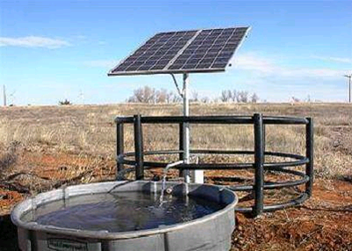
Generating Renewable Energy - Solar
Solar energy can be used to
heat water for dairies,
air for grain drying,
provide remote electricity.
Over 8,000 American farms are producing and using solar energy, with installations in every state.
Just 20 days of sunshine-based energy is equal to all of the energy stored in the earth’s reserves of coal, oil, and natural gas.

Slide 3
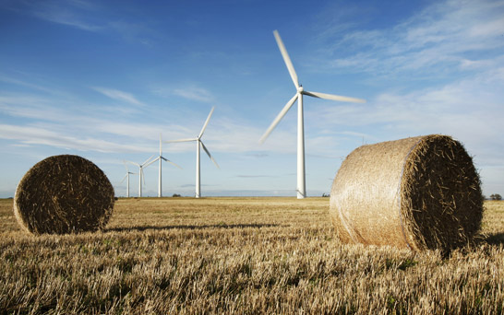
Generating Renewable Energy - Wind
There are ~2,000 wind turbines owned and operated by farmers in the U.S. (excluding commercial wind farms.)
Wind power is the fastest growing new source of electricity in America.
Wind projects in 2008 accounted for 46% of new electricity capacity added nationally.
Leasing small plots of land for wind turbines offers farmers a new source of income.
Land leases could generate more than $500 million in revenue in 2020.
Leases are often calculated by wind capacity
Average land lease price currently is $3,500 per megawatt of wind capacity

Slide 4
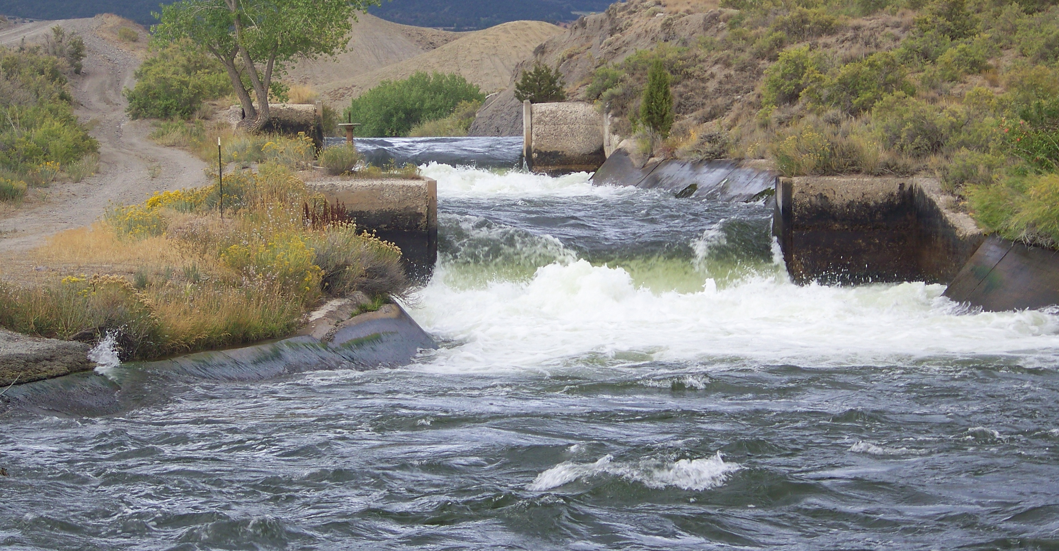
Generating Renewable Energy - Water
Hydropower can be scaled down to generate electricity from small rivers, streams, and even irrigation canals.

Slide 5
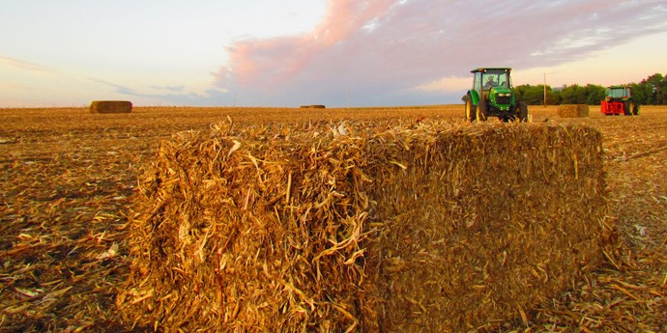
Generating Renewable Energy - Plants
Plant matter (biomass) can be used to generate electricity and heat
Biomass can be refined into liquid fuels.
A major source of new farm revenue will come from the sale of crop wastes as bioenergy feedstocks.
Based on USDA estimâtes, 100 million dry tons of corn stover and other agricultural residues could be harvested sustainably on U.S. farms in the year 2020.
At a market price of $50 per dry ton farmers could earn roughly $4 billion in annual profits

Slide 6
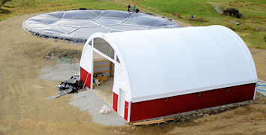
Generating Renewable Energy - Animals
Methane captured from animal waste through anaerobic digestion can be used for electrical generation and heating.
Methane digesters on American farms are producing about half a million megawatt hours (MWh) each year.
Livestock farmers can earn “offset” credits from cutting harmful methane emissions.
EPA estimates that biogas recovery systems on farms could generate 6 million MWh of electricity per year.
Biogas could offset more than 7% of the agricultural sector’s electricity consumption in 2020 resulting in a cost savings of approximately $190 million.
The sale of offset credits could add another $60 million of income

Slide 7
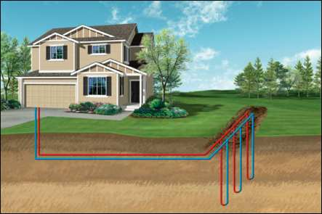
Generating Renewable Energy - Geothermal
Underground geothermal energy can be used to heat air and water, or even power generators.
Geothermal energy uses the near-constant heat of the earth for thermal heating and cooling needs.
Electricity can even be produced where hot enough reserves are accessible.

Slide 8
Importance of Renewable Energy
Economics
Food Security
National Security
Energy Independence
Environmental Protection
Health Concerns from Pollution

Slide 9
Importance of Renewable Energy
World Energy Consumption by Source, Based on Vaclav Smil estimates from Energy Transitions (ourfiniteworld.com)

Slide 10
Importance of Renewable Energy
Energy choices have direct implications on health, environment, and climate.
We are largely dependent on coal and other fossil fuels for most of our electricity needs.
Power generation is a leading cause of air pollution and is the single largest source of U.S. global warming emissions.
Renewable energy resources generate electricity with little to no pollution or global warming emissions
Renewable energy could provide up to 40 percent of U.S. electricity needs within the next 20 years.

Slide 11
U.S. Energy Consumption
*Sum of biomass components does not equal 53% due to independent rounding
Source: U.S. Energy Information Administration, 2010 Annual Energy Review

Slide 12
Energy Potential
https://maps.nrel.gov/re-atlas/

Slide 13
Careers in Renewable Energy
https://youtu.be/o42DtGQPg5k

